Slide 1
C)
TECNICAL and RESULTS OF 1283 PATIENS
at METABOLIC ASPECTS 12 years revision
G. Lesti
EUROPEAN PATENT n. 3030202
USA REGISTERED n BX3609R/REPH/rrr
OBESITY SURGERY :vol.28 ,Issue 9 September 2018
VIDEO Accepted by OBESITY SURGERY April 2021

Slide 2
GASTRIC BYPASS BY E.MASON 1966
The stomach can not be
explored, the patient can not
perform a diagnostic and
operative gastroscopy
The same appen with mimi gastric bypass
I think that, in the era of operative endoscopy, this is a real limitation

Slide 3
NOVEL LAPAROSCOPIC REVERSABLE GASTRIC BAYPASS WITH FUNDECTOMY AND ESPLORABLE STOMACH (Lesti model)
*C
.
The relationships among food ,stomach, small bowels and hormones are better known nowadays. These relationships have to be very well known in designing surgical procedures for the treatment of obesity.
** Grelin, PYY, GLP-1, GIP, CCK, all these hormones play an important role in controlling the food intake; therefore, the actions of these hormones should be very well known in selecting the right procedure.

Slide 4
NOVEL LAPAROSCOPIC REVERSABLE GASTRIC BAYPASS WITH FUNDECTOMY AND ESPLORABLE STOMACH
*The study of Brolin et al, offers the first level evidence showing the importance of limbs length, it is hard to determine whether the beneficial effects depend on the length of the alimentary limb ,or more likely, of the common channel. Whatever the reason : “ the limbs lengths play an important role in the metabolic effect of gastric bypass.
Our behaviour take in mind :the food should arrive as sooner as possible to the jlium to henancing the secretion of very important hormons as GLP1 and the PYY

Slide 5
NOVEL LAPAROSCOPIC REVERSABLE GASTRIC BAYPASS WITH FUNDECTOMY AND ESPLORABLE STOMACH
The metabolic benefits of a longer biliary limb can be demonstrated in the OARYGB
OARYGB (mini gastric bypass) with a unique 200-cm bypassed biliary limb; diabetes remission is reported in more than 90% of cases. It’s possible that a longer BP limb,, could have metabolic advantages as it could deliver nutrients to the ileum more quickly ,whit the early release of GLP-1/ PYY
.

Slide 6
NOVEL LAPAROSCOPIC REVERSABLE GASTRIC BAYPASS WITH
FUNDECTOMY AND ESPLORABLE STOMACH
Sixteen studies on 325 patients with LRYGB.
** The regression meta analysis shows that the volume of the pouch, the length of biliary and alimentary limbs were not associated with variation of grelin level
** The Grelin level decreases in the first 3 months, but increases afterwards
** It is clear that Grelin does not play an important role in the LRYGBP
Systemic review and metabolic of the change in Grelin level after LRYGB.
OBESITY SURGERY April 2019 volume 29 pag.1343-1351

Slide 7
NOVEL LAPAROSCOPIC REVERSABLE GASTRIC BAYPASS WITH FUNDECTOMY AND ESPLORABLE STOMACH.
After RYGP, the following results can be observed, with important metabolic effects: gastric restriction leading to early satiety, and decreasing the volume of the meals; The resection of the fundus of the stomach leading to a reduction in the secretion of grelin and subsequent anorexigenic effect; faster arrival of nutrients to the distal intestine, in order to stimulate the release of PYY and GLP-1, which lead to decreased food intake and improve glucose tolerance (Rubino 2006; Cummings 2007)
ALL OF THEESE RULE ARE RAPRESENTED IN MY MODEL OF REVERSABLE GASTRIC BY PASS first made in 2004 vhith the last revision at 2010.

Slide 8
NOVEL LAPAROSCOPIC REVERSABLE GASTRIC BAYPASS WITH FUNDECTOMY AND ESPLORABLE STOMACH.
* The challenging diagnosis and treatment of diseases in the gastric remnant, duodenum, and common bile duct are major limitations
* Cancer or bleeding ulcer located in the gastric remnant are possible life-threatening conditions
* It has been shown that up to 10% patients after RYGB may develop cholelithiasis and up1% coholedoco lithiasis.
*The laparoscopic gastric bypass with fundectomy and
gastric remnant exploration (LRYGBfse) was introduced in
order to overcome these limitations of the LRYGB.

Slide 9
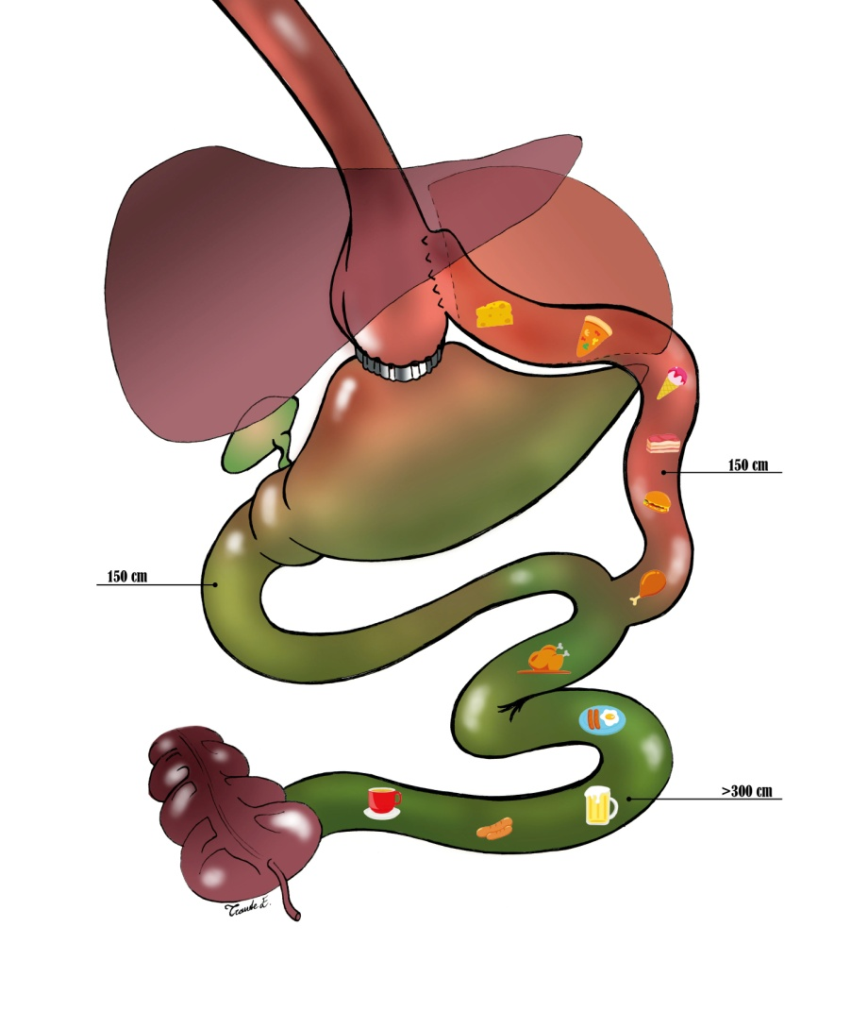
LAPAROSCOPIC REVERSABLE GASTRIC BAYPASS WITH FUNDECTOMY AND ESPLORABLE STOMACH.
25 pts Grelin (n.v. 200-800 pm)
medium value pre-op: 660pm/l
medium value at 30 days: 76pm/l
at 6 month: 93pm/l
at 12 month: 109pm/l
The biliary limbs are 200 cm ; the alimentary
limbs are100 cm; //with BMI over 45 the
alimentary limbs are 150 cm.
If the C.C. is less than 300 cm, the alimentary
limb is reduced, not the biliary limb.

Slide 10
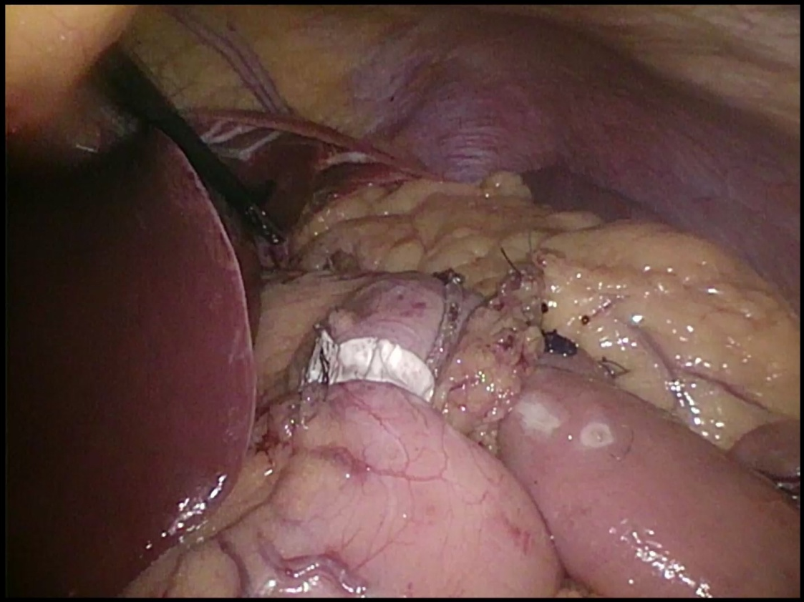
NOVEL LAPAROSCOPIC REVERSABLE GASTRIC BAYPASS WITH FUNDECTOMY AND ESPLORABLE STOMACH.
.
The food doesn’t pass through the duodenum and the first part of Jujunum (Rubino Theory)
The food meets the bile in the first part of ileum or in the last part of the Jujiunum?
This gastric bypass is in line with the fore gut and hind gut theory.

Slide 11
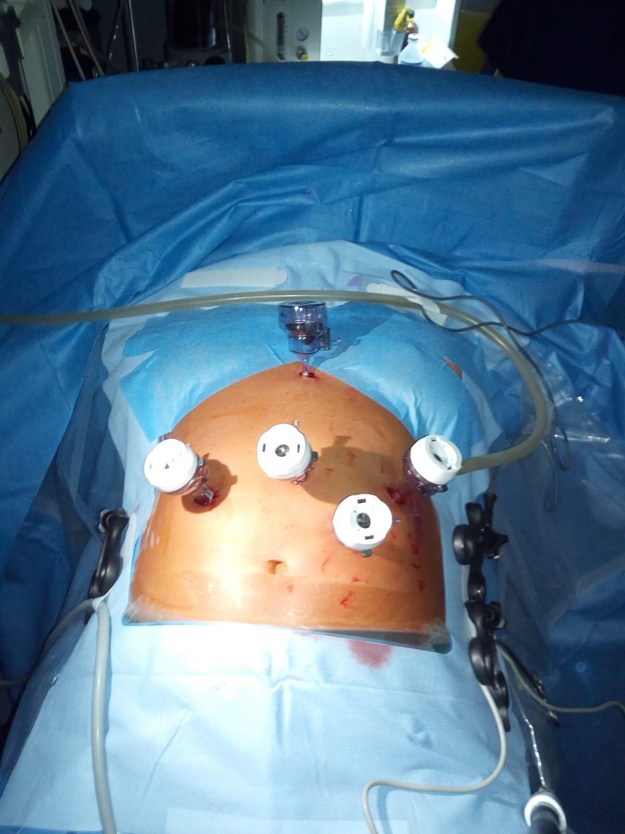
NOVEL LAPAROSCOPIC REVERSABLE GASTRIC BAYPASS WITH FUNDECTOMY AND ESPLORABLE STOMACH.

Slide 12
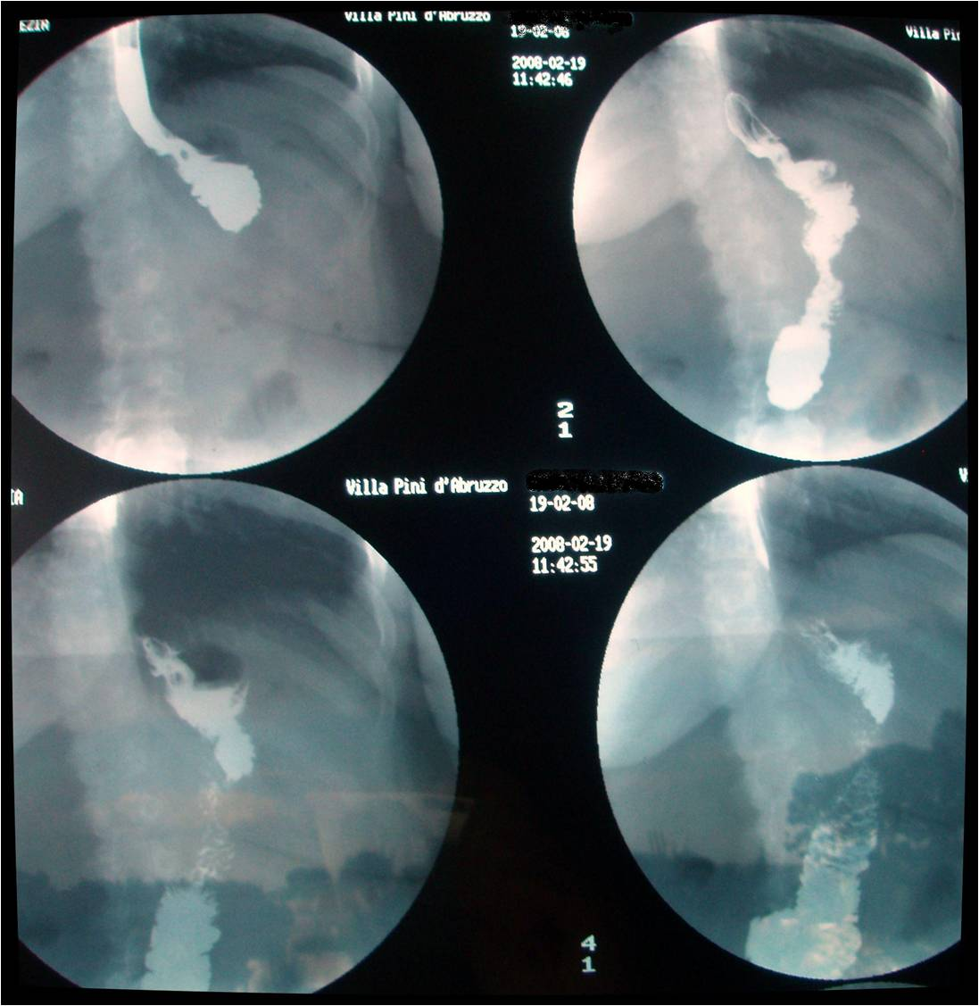
NOVEL LAPAROSCOPIC REVERSABLE GASTRIC BAYPASSN WITH FUNDECTOMY AND ESPLORABLE STOMACH.
The x ray shows the passage of barium directly to the alimentary limb..
Nothing goes through the remnant
stomach.

Slide 13
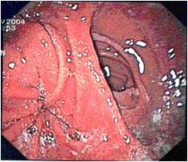
NOVEL LAPAROSCOPIC REVERSABLE GASTRIC BAYPASSN WITH FUNDECTOMY AND ESPLORABLE STOMACH.
All patients have a gastroscopy after 1 and 5 years: rarely
bile has been found in the gastric pouch.
It is important to underline
that no gastro-gastro fistula is created. We have found, in our patients, only 5 ulcers in very heavy smokers.
.

Slide 14
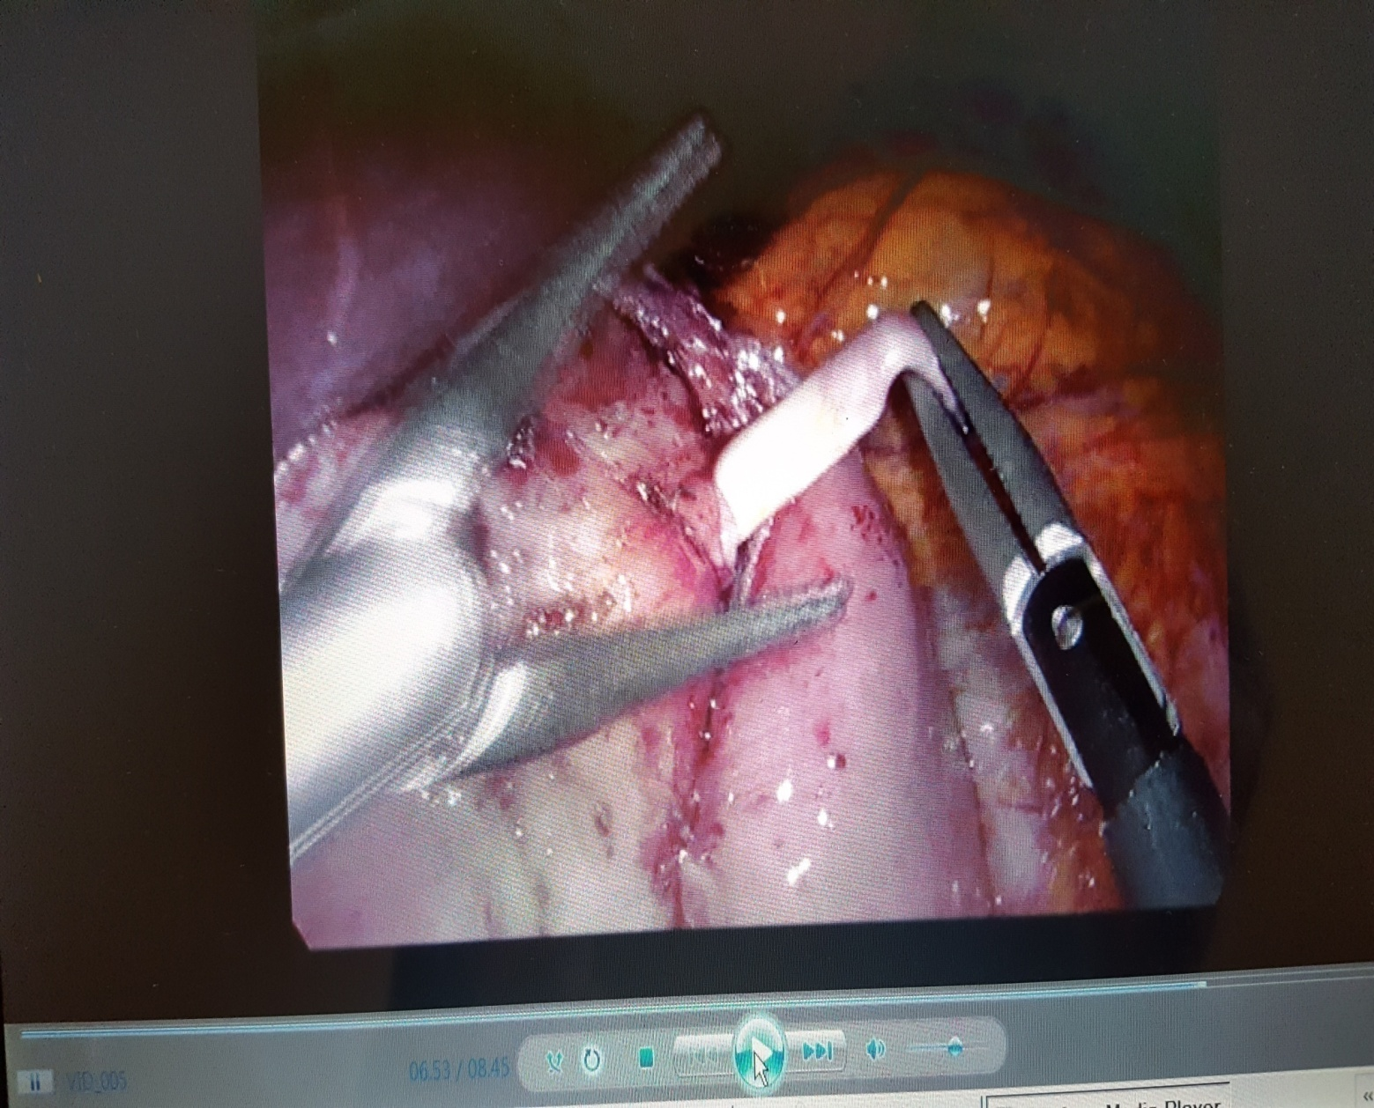
_{The patient, smoker of} _{40 cigarettes a day,} at the fourth month of pregnancy, was suffering
_{from an} ulcer of the gastro-jejunal anastomosis totally occluding the _{passage of foud}
The band was removed and the patient had a beby 4 months later.

Slide 15
NOVEL LAPAROSCOPIC REVERSABLE GASTRIC BAYPASS WITH FUNDECTOMY AND ESPLORABLE STOMACH
In our group of patients, endoscopic retrograde cholangio-pancreatography (ERCP) was necessary in 3 patients for symptomatic choledocolithiasis at 28 e 37 and 51 months respectively after the LRYGB (FSE). The procedures were done without complications.
In the same group, 2 patients had a pre-pyloric cancer 32 and 45 months after the LRYGB (FSE). The diagnosis was made during the annual gastroscopic controll in early phase ;a gastrectomy with D2 lymphadenectomy was performed in both patients. The pouch was preserved in both patients.
Risk of gastric cancer after RYGB should be evaluated and considered in high-risk cases. Also the minigastric bypass have the same problability

Slide 16
NOVEL LAPAROSCOPIC REVERSABLE GASTRIC BAYPASS WITH FUNDECTOMY AND ESPLORABLE STOMACH
Oesophageal and Gastric Cancer After Bariatric Surgery: an Up-to-Date Systematic Scoping Review of Literature of 324 Cases
Obesity Surgery volume 32, pages3854–3862 (2022)Cite this article
Published: 15 October 2022

Slide 17
NOVEL LAPAROSCOPIC REVERSABLE GASTRIC BAYPASS WITH FUNDECTOMY AND ESPLORABLE STOMACH
No. of patients 1243
Age, years, median (range) 38,4 (22–67)
Females, 753//Male .490
Pre op body weight, kg, median (range) 123.4 (87–152)
Pre op BMI, kg/m2, median (range) 44,8 (34–56.6)
BMI 35–< 40 kg/m2, (12.5%)
BMI 40–< 50 kg/m2, (79,4%)
BMI 50–< 60 kg/m2, (8.1%)
Post-operative stay( days ) 4.74 (3- 8 )
Mean operating time 122min. ( 98 - 227)

Slide 18
NOVEL LAPAROSCOPIC REVERSABLE GASTRIC BYPASS WITH FUNDECTOMY AND ESPLORABLE STOMACH
(
Time | Weight (kg) | BMI (kg/m2) | %EWL
Pre-op | 114 ± 8.9 | 44,8 ± 7.5 | ------
1 year follow-up (143 ) | 83.2 ± 11.3 | 37,8 ± 2.9 | 74.2 ± 17.4
2 years follow-up (237) | 81.3 ± 12.5 | 29.5 ± 2.6 | 73.2 ± 16,4
3 years follow-up ((412) | 81.7 ± 11.6 | 29.6 ± 6.2 | 73,6 ± 16.2
5 years follow-up (643) | 81.1 ± 12.8 | 31.5 ± 5.7 | 71,35 ± 17.3
7 years follow up (841) | 83.7 ± 11.50 | 30,3 ± 3.7 | 67,72 ± 16.8
10 years follow up (1247 ) | 87.8 ± 11.50 | 32.4 ± 2.5 | 68,59 ± 16.3

Slide 19
NOVEL LAPAROSCOPIC REVERSABLE GASTRIC BAYPASS WITH FUNDECTOMY AND ESPLORABLE STOMACH
Comorbidities resolution at 10 years
Resolution Improvement No change
*Hypertension (49.5%) 67,4% 26,1 % 6,5%
*Dyslipidemia (47.3%) 75,3% 24,7% -------
*GERD (37.6%) 84,8% 15,2% --------
*Diabetes (24.6%) 68,5% 21,4% 10,1%
*OSAS (19.4%) 60,5% 39,5% --------
*Depression (17.5%) 86,4% 13,6%

Slide 20
NOVEL LAPAROSCOPIC REVERSABLE GASTRIC BAYPASS WITH FUNDECTOMY AND ESPLORABLE STOMACH
MAJOR COMPLICATIONS
The overall procedure-related morbidity
Mortality 0
Leaks 4
Bleeding/reoperations 5
Ulcers (heavy smockers) 12
Ulcers Not heavy smochers 6
Internal hernias/reoperations 4
Stricture 0

Slide 21
NOVEL LAPAROSCOPIC REVERSABLE GASTRIC BAYPASS WITH FUNDECTOMY AND ESPLORABLE STOMACH
*CONSIDERATIONS and IMPROVEMENTS
The main point of these banded procedures is the device!!! This device should have such elasticity to gently close the passage from the pouch to the remnant stomach of the solid and liquid food; at the same time, it should not allow any passage of the bile from the remnant stomach to the pouch. Moreover, it should permit the passage not only of the diagnostic 5 mm endoscope, but also the operative endoscope 10 mm.

Slide 22
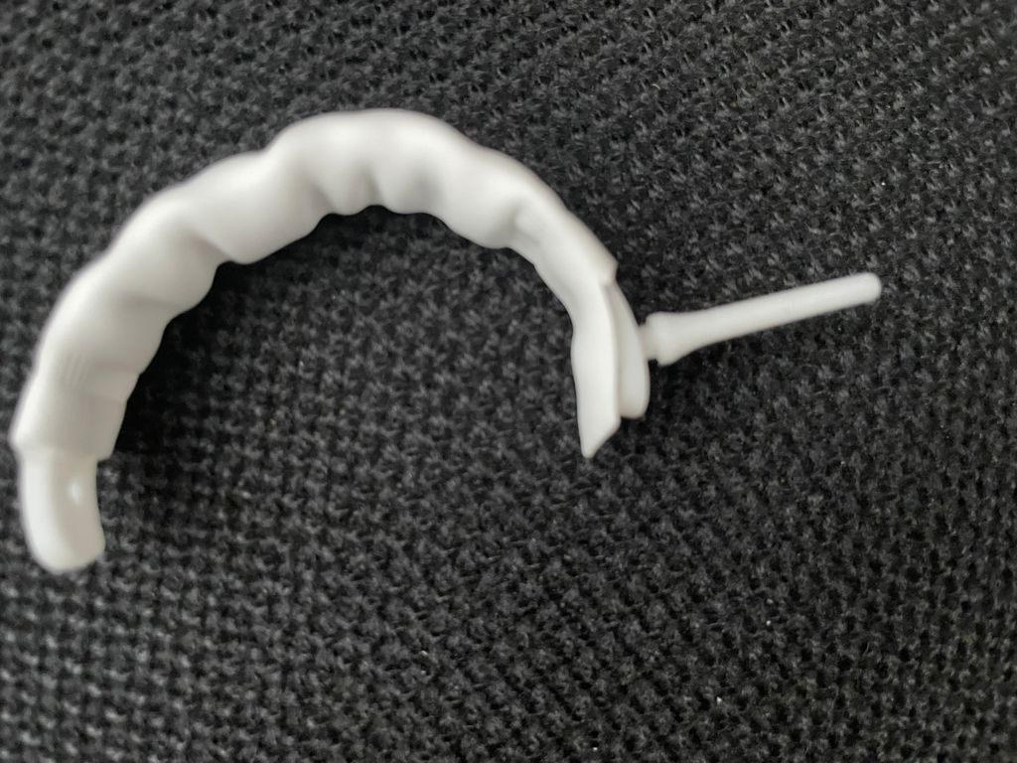
DCB is made by a silicon strip inside a tube of ePTFE 4, cm longer.The two materials are fixed at the end. The ePTFE assume an accordian shape The silicon strip has three measures:5,6,7 cm

Slide 23
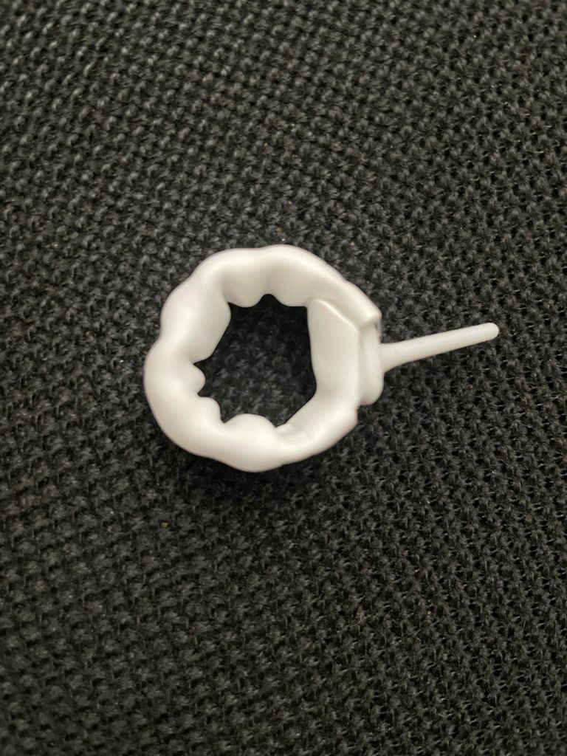
DCB is made by a silicon strip inside a tube of ePTFE 4 cm longer. The two materials are fixed at the end. The ePTFE assumes an accordian shape.
The silicon strip has three measures: 5,6,7 cm long

Slide 24
NOVEL LAPAROSCOPIC REVERSABLE GASTRIC BYPASS WITH FUNDECTOMY AND ESPLORABLE STOMACH
. Prof. Giovanni Lesti has created a variant of the GASTRIC BY PASS with an explorable in residual stomach. The report, which I attach, was presented at the IFSO congress in Naples July 2023.My group has also started in doing this technique in the Mini Gastric Bypass. The construction is relatively simple and duration rarely exceeds 120.minuti

Slide 25
NOVEL LAPAROSCOPIC REVERSABLE GASTRIC BAYPASS WITH FUNDECTOMY AND ESPLORABLE STOMACH
OPZIONI DI RISPOSTA 90%
Sì. Lo conosco, lo considero un intervento valido e lo eseguo
in tutti i pazienti che hanno indicazioni al RYGB 7,50%
Sì. Lo conosco, lo considero un intervento valido e lo eseguo
in pazienti selezionati 12,50%
Sì. Lo conosco, lo considero un intervento valido;
ma non lo eseguo 40,00%
Sì. Lo conosco ma non lo considero un intervento valido
e pertanto non lo eseguo 30,00%

Slide 26
NOVEL LAPAROSCOPIC REVERSABLE GASTRIC BAYPASS WITH FUNDECTOMY AND ESPLORABLE STOMACH
ANSWER OF THE ITALIAN SERGEONS
Yes. I know it, I consider it a valid intervention and I carry it out in all patients who have indications for RYGB 7.50%
Yes. I know it, I consider it a valid intervention
and I perform it in selected patients 12.50%
Yes. I know it, I consider it a valid intervention;
but I don't do in this time 40.00%
I know about it but I don't consider it a valid
intervention and therefore I don't do it 30.00%

Slide 27
NOVEL LAPAROSCOPIC REVERSABLE GASTRIC BAYPASS WITH FUNDECTOMY AND ESPLORABLE STOMACH
A smol group is doing many mini gastric bypasses always with an explorable of remanent stomach; the results are very good; Furthermore, this technique is very simple and quite fast. The closure of the bandage closes the passage of food into the residual stomach which can therefore be explored.

Slide 28


